Slide 1
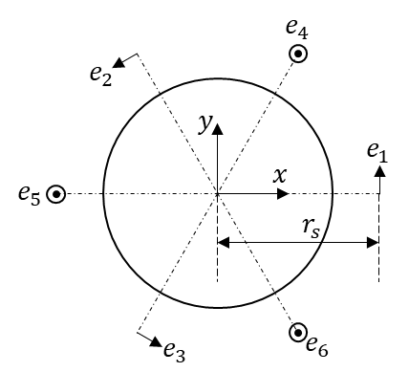
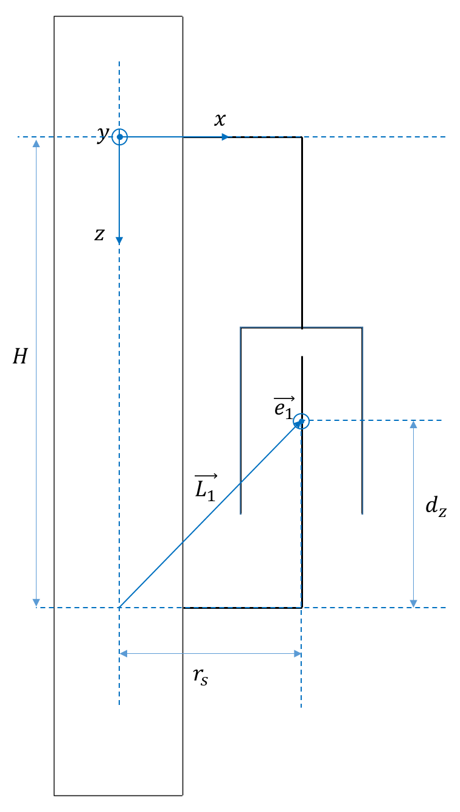
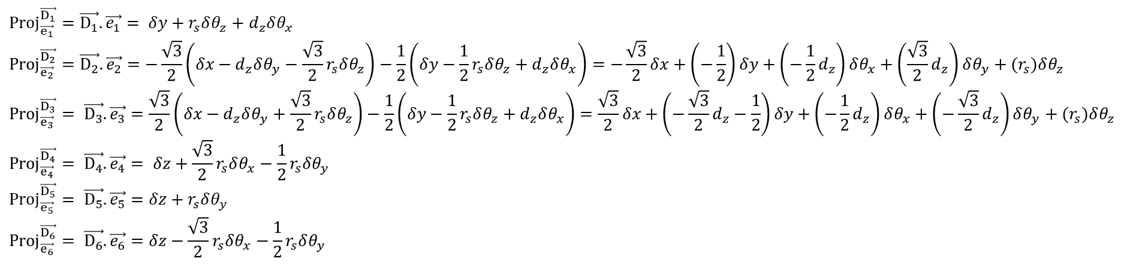
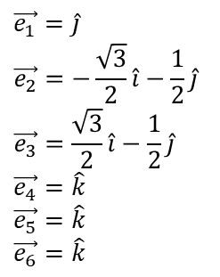
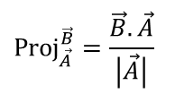
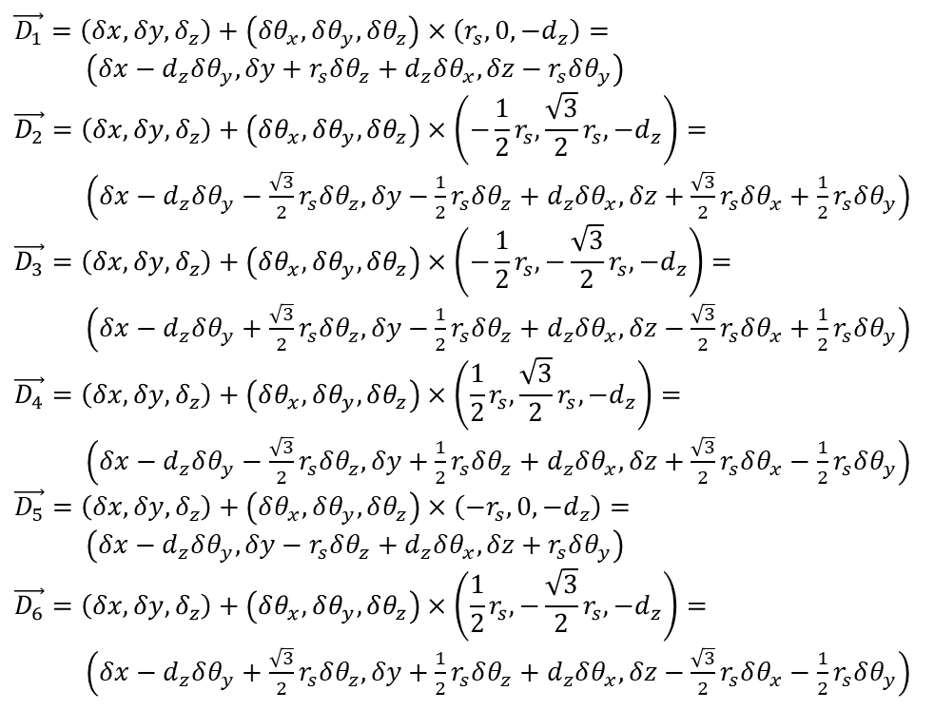
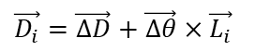
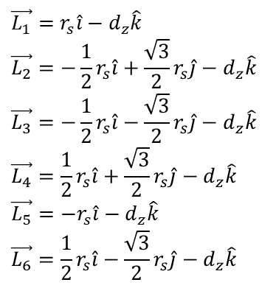
$$\vec{D_{i}}=\vec{ΔD}+\vec{Δθ}×\vec{L_{i}}$$
$$\vec{D_{1}}=\left(δx,δy,δ_{z}\right)+\left(δθ_{x},δθ_{y},δθ_{z}\right)×\left(r_{s},0,−d_{z}\right)=$$ $\left(δx−d_{z}δθ_{y},δy+r_{s}δθ_{z}+d_{z}δθ_{x}, δz−r_{s}δθ_{y}\right)$
$$\vec{D_{2}}=\left(δx,δy,δ_{z}\right)+\left(δθ_{x},δθ_{y},δθ_{z}\right)×\left(−\frac{1}{2}r_{s},\frac{\sqrt{3}}{2}r_{s},−d_{z}\right)=$$ $\left(δx−d_{z}δθ_{y}−\frac{\sqrt{3}}{2}r_{s}δθ_{z},δy−\frac{1}{2}r_{s}δθ_{z}+d_{z}δθ_{x}, δz+\frac{\sqrt{3}}{2}r_{s}δθ_{x}+\frac{1}{2}r_{s}δθ_{y}\right)$
$$\vec{D_{3}}=\left(δx,δy,δ_{z}\right)+\left(δθ_{x},δθ_{y},δθ_{z}\right)×\left(−\frac{1}{2}r_{s},−\frac{\sqrt{3}}{2}r_{s},−d_{z}\right)=$$ $\left(δx−d_{z}δθ_{y}+\frac{\sqrt{3}}{2}r_{s}δθ_{z},δy−\frac{1}{2}r_{s}δθ_{z}+d_{z}δθ_{x}, δz−\frac{\sqrt{3}}{2}r_{s}δθ_{x}+\frac{1}{2}r_{s}δθ_{y}\right)$
$$\vec{D_{4}}=\left(δx,δy,δ_{z}\right)+\left(δθ_{x},δθ_{y},δθ_{z}\right)×\left(\frac{1}{2}r_{s},\frac{\sqrt{3}}{2}r_{s},−d_{z}\right)=$$ $\left(δx−d_{z}δθ_{y}−\frac{\sqrt{3}}{2}r_{s}δθ_{z},δy+\frac{1}{2}r_{s}δθ_{z}+d_{z}δθ_{x}, δz+\frac{\sqrt{3}}{2}r_{s}δθ_{x}−\frac{1}{2}r_{s}δθ_{y}\right)$
$$\vec{D_{5}}=\left(δx,δy,δ_{z}\right)+\left(δθ_{x},δθ_{y},δθ_{z}\right)×\left(−r_{s},0,−d_{z}\right)=$$ $\left(δx−d_{z}δθ_{y},δy−r_{s}δθ_{z}+d_{z}δθ_{x}, δz+r_{s}δθ_{y}\right)$
$$\vec{D_{6}}=\left(δx,δy,δ_{z}\right)+\left(δθ_{x},δθ_{y},δθ_{z}\right)×\left(\frac{1}{2}r_{s},−\frac{\sqrt{3}}{2}r_{s},−d_{z}\right)=$$ $\left(δx−d_{z}δθ_{y}+\frac{\sqrt{3}}{2}r_{s}δθ_{z},δy+\frac{1}{2}r_{s}δθ_{z}+d_{z}δθ_{x}, δz−\frac{\sqrt{3}}{2}r_{s}δθ_{x}−\frac{1}{2}r_{s}δθ_{y}\right)$
$$\vec{e_{1}}=\hat{j}$$
$$\vec{e_{2}}=−\frac{\sqrt{3}}{2}\hat{i}−\frac{1}{2}\hat{j}$$
$$\vec{e_{3}}=\frac{\sqrt{3}}{2}\hat{i}−\frac{1}{2}\hat{j}$$
$$\vec{e_{4}}=\hat{k}$$
$$\vec{e_{5}}=\hat{k}$$
$$\vec{e_{6}}=\hat{k}$$
$$\vec{L_{1}}=r_{s}\hat{i}−d_{z}\hat{k}$$
$$\vec{L_{2}}=−\frac{1}{2}r_{s}\hat{i}+\frac{\sqrt{3}}{2}r_{s}\hat{j}−d_{z}\hat{k}$$
$$\vec{L_{3}}=−\frac{1}{2}r_{s}\hat{i}−\frac{\sqrt{3}}{2}r_{s}\hat{j}−d_{z}\hat{k}$$
$$\vec{L_{4}}=\frac{1}{2}r_{s}\hat{i}+\frac{\sqrt{3}}{2}r_{s}\hat{j}−d_{z}\hat{k}$$
$$\vec{L_{5}}=−r_{s}\hat{i}−d_{z}\hat{k}$$
$$\vec{L_{6}}=\frac{1}{2}r_{s}\hat{i}−\frac{\sqrt{3}}{2}r_{s}\hat{j}−d_{z}\hat{k}$$
$${Proj}_{\vec{A}}^{\vec{B}}=\frac{\vec{B}.\vec{A}}{\left|\vec{A}\right|}$$
$${Proj}_{\vec{e_{1}}}^{\vec{D_{1}}}=\vec{D_{1}}.\vec{e_{1}}= δy+r_{s}δθ_{z}+d_{z}δθ_{x}$$
$${Proj}_{\vec{e_{2}}}^{\vec{D_{2}}}=\vec{D_{2}}.\vec{e_{2}}=−\frac{\sqrt{3}}{2}\left(δx−d_{z}δθ_{y}−\frac{\sqrt{3}}{2}r_{s}δθ_{z}\right)−\frac{1}{2}\left(δy−\frac{1}{2}r_{s}δθ_{z}+d_{z}δθ_{x}\right)=−\frac{\sqrt{3}}{2}δx+\left(−\frac{1}{2}\right)δy+\left(−\frac{1}{2}d_{z}\right)δθ_{x}+\left(\frac{\sqrt{3}}{2}d_{z}\right)δθ_{y}+(r_{s})δθ_{z}$$
$${Proj}_{\vec{e_{3}}}^{\vec{D_{3}}}= \vec{D_{3}}.\vec{e_{3}}=\frac{\sqrt{3}}{2}\left(δx−d_{z}δθ_{y}+\frac{\sqrt{3}}{2}r_{s}δθ_{z}\right)−\frac{1}{2}\left(δy−\frac{1}{2}r_{s}δθ_{z}+d_{z}δθ_{x}\right)=\frac{\sqrt{3}}{2}δx+\left(−\frac{\sqrt{3}}{2}d_{z}−\frac{1}{2}\right)δy+\left(−\frac{1}{2}d_{z}\right)δθ_{x}+\left(−\frac{\sqrt{3}}{2}d_{z}\right)δθ_{y}+(r_{s})δθ_{z}$$
$${Proj}_{\vec{e_{4}}}^{\vec{D_{4}}}= \vec{D_{4}}.\vec{e_{4}}= δz+\frac{\sqrt{3}}{2}r_{s}δθ_{x}−\frac{1}{2}r_{s}δθ_{y}$$
$${Proj}_{\vec{e_{5}}}^{\vec{D_{5}}}= \vec{D_{5}}.\vec{e_{5}}=δz+r_{s}δθ_{y}$$
$${Proj}_{\vec{e_{6}}}^{\vec{D_{6}}}= \vec{D_{6}}.\vec{e_{6}}=δz−\frac{\sqrt{3}}{2}r_{s}δθ_{x}−\frac{1}{2}r_{s}δθ_{y}$$

Slide 2
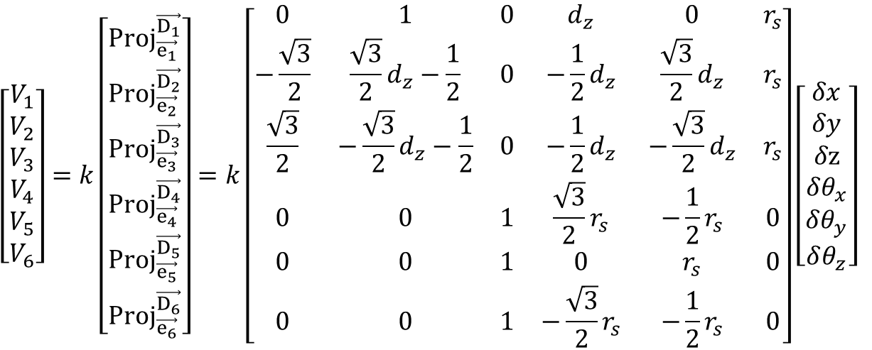
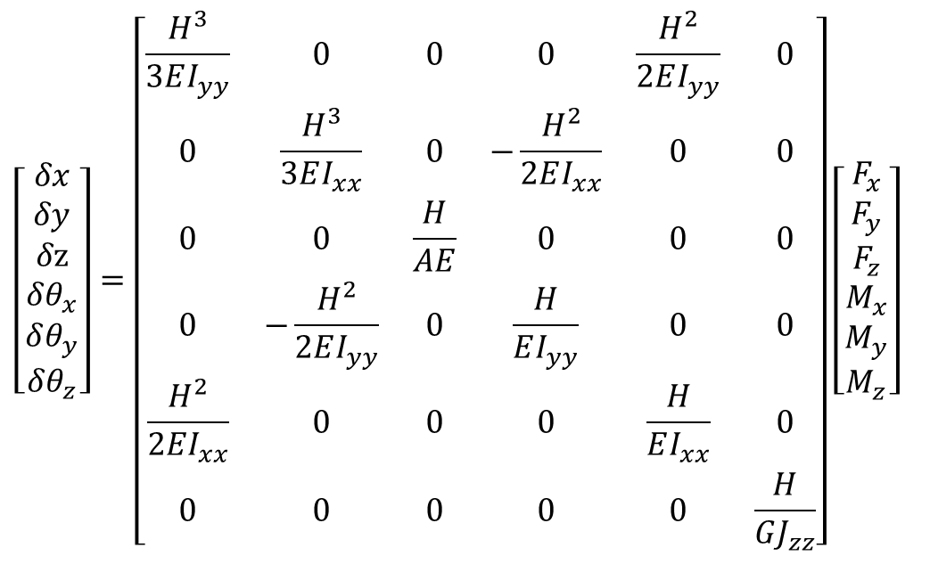
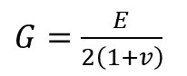
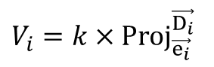
$$V_{i}=k×{Proj}_{\vec{e_{i}}}^{\vec{D_{i}}}$$
$G=\frac{E}{2\left(1+v\right)}$
$$\left[\begin{aligned}V_{1} \\ V_{2} \\ V_{3} \\ V_{4} \\ V_{5} \\ V_{6}\end{aligned}\right]=k\left[\begin{aligned}{Proj}_{\vec{e_{1}}}^{\vec{D_{1}}} \\ {Proj}_{\vec{e_{2}}}^{\vec{D_{2}}} \\ {Proj}_{\vec{e_{3}}}^{\vec{D_{3}}} \\ {Proj}_{\vec{e_{4}}}^{\vec{D_{4}}} \\ {Proj}_{\vec{e_{5}}}^{\vec{D_{5}}} \\ {Proj}_{\vec{e_{6}}}^{\vec{D_{6}}}\end{aligned}\right]=k\left[\begin{matrix}0 & 1 & 0 & d_{z} & 0 & r_{s} \\ −\frac{\sqrt{3}}{2} & \frac{\sqrt{3}}{2}d_{z}−\frac{1}{2} & 0 & −\frac{1}{2}d_{z} & \frac{\sqrt{3}}{2}d_{z} & r_{s} \\ \frac{\sqrt{3}}{2} & −\frac{\sqrt{3}}{2}d_{z}−\frac{1}{2} & 0 & −\frac{1}{2}d_{z} & −\frac{\sqrt{3}}{2}d_{z} & r_{s} \\ 0 & 0 & 1 & \frac{\sqrt{3}}{2}r_{s} & −\frac{1}{2}r_{s} & 0 \\ 0 & 0 & 1 & 0 & r_{s} & 0 \\ 0 & 0 & 1 & −\frac{\sqrt{3}}{2}r_{s} & −\frac{1}{2}r_{s} & 0\end{matrix}\right]\left[\begin{matrix}\begin{aligned}δx \\ δy \\ δz \\ δθ_{x}\end{aligned} \\ δθ_{y} \\ δθ_{z}\end{matrix}\right]$$
$$\left[\begin{matrix}\begin{aligned}δx \\ δy \\ δz \\ δθ_{x}\end{aligned} \\ δθ_{y} \\ δθ_{z}\end{matrix}\right]=\left[\begin{matrix}\frac{H^{3}}{3EI_{yy}} & 0 & 0 & 0 & \frac{H^{2}}{2EI_{yy}} & 0 \\ 0 & \frac{H^{3}}{3EI_{xx}} & 0 & −\frac{H^{2}}{2EI_{xx}} & 0 & 0 \\ 0 & 0 & \frac{H}{AE} & 0 & 0 & 0 \\ 0 & −\frac{H^{2}}{2EI_{yy}} & 0 & \frac{H}{EI_{yy}} & 0 & 0 \\ \frac{H^{2}}{2EI_{xx}} & 0 & 0 & 0 & \frac{H}{EI_{xx}} & 0 \\ 0 & 0 & 0 & 0 & 0 & \frac{H}{GJ_{zz}}\end{matrix}\right]\left[\begin{aligned}F_{x} \\ F_{y} \\ F_{z} \\ M_{x} \\ M_{y} \\ M_{z}\end{aligned}\right]$$

Slide 3
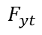
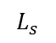
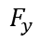
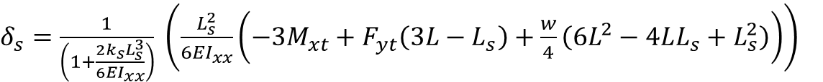
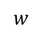
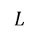
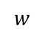
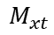
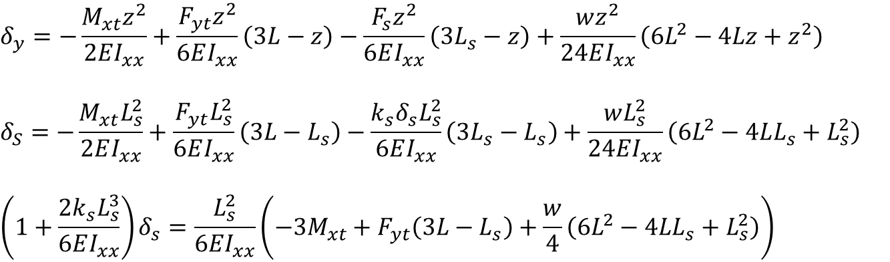
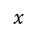
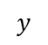
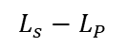
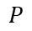
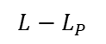
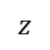
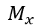
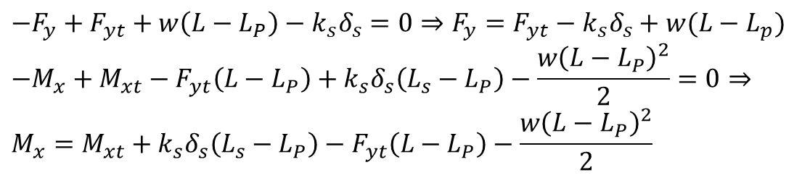
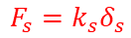
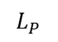
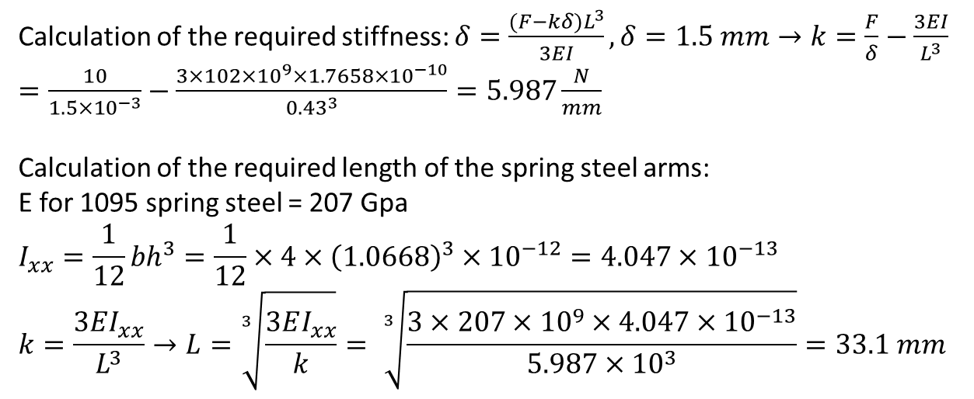
$$y$$
Calculation of the required stiffness: $δ=\frac{(F−kδ)L^{3}}{3EI}, δ=1.5 mm→k=\frac{F}{δ}−\frac{3EI}{L^{3}}=\frac{10}{1.5×{10}^{−3}}−\frac{3×102×{10}^{9}×1.7658×{10}^{−10}}{{0.43}^{3}}=5.987\frac{N}{mm}$
Calculation of the required length of the spring steel arms:
E for 1095 spring steel = 207 Gpa
$$I_{xx}=\frac{1}{12}{bh}^{3}=\frac{1}{12}×4×{\left(1.0668\right)}^{3}×{10}^{−12}=4.047×{10}^{−13}$$
$$k=\frac{3EI_{xx}}{L^{3}}→L=\sqrt[3]{\frac{3EI_{xx}}{k}}= \sqrt[3]{\frac{3×207×{10}^{9}×4.047×{10}^{−13}}{5.987×{10}^{3}}}=33.1 mm$$
$$x$$
$$z$$
$$F_{s}=k_{s}δ_{s}$$
$$L_{P}$$
$$P$$
$$s$$
$$M_{xt}$$
$$w$$
$$F_{yt}$$
$$L_{s}$$
$$L$$
$$F_{y}$$
$$F_{s}=k_{s}δ_{s}$$
$$M_{x}$$
$$P$$
$$s$$
$$M_{xt}$$
$$δ_{y}=−\frac{M_{xt}z^{2}}{2EI_{xx}}+\frac{F_{yt}z^{2}}{6EI_{xx}}\left(3L−z\right)−\frac{F_{s}z^{2}}{6EI_{xx}}\left(3L_{s}−z\right)+\frac{wz^{2}}{24EI_{xx}}\left(6L^{2}−4Lz+z^{2}\right)$$
$$δ_{S}=−\frac{M_{xt}L_{s}^{2}}{2EI_{xx}}+\frac{F_{yt}L_{s}^{2}}{6EI_{xx}}\left(3L−L_{s}\right)−\frac{k_{s}δ_{s}L_{s}^{2}}{6EI_{xx}}\left(3L_{s}−L_{s}\right)+\frac{wL_{s}^{2}}{24EI_{xx}}\left(6L^{2}−4LL_{s}+L_{s}^{2}\right)$$
$$\left(1+\frac{2k_{s}L_{s}^{3}}{6EI_{xx}}\right)δ_{s}=\frac{L_{s}^{2}}{6EI_{xx}}\left(−3M_{xt}+F_{yt}\left(3L−L_{s}\right)+\frac{w}{4}\left(6L^{2}−4LL_{s}+L_{s}^{2}\right)\right)$$
$$w$$
$$F_{yt}$$
$$L_{s}−L_{P}$$
$$L−L_{P}$$
$δ_{s}=\frac{1}{\left(1+\frac{2k_{s}L_{s}^{3}}{6EI_{xx}}\right)} \left(\frac{L_{s}^{2}}{6EI_{xx}}\left(−3M_{xt}+F_{yt}\left(3L−L_{s}\right)+\frac{w}{4}\left(6L^{2}−4LL_{s}+L_{s}^{2}\right)\right)\right)$
$$−F_{y}+F_{yt}+w\left(L−L_{P}\right)−k_{s}δ_{s}=0⇒F_{y}={F_{yt}−k}_{s}δ_{s}+w(L−L_{p})$$
$$−M_{x}+M_{xt}−F_{yt}\left(L−L_{P}\right)+k_{s}δ_{s}\left(L_{s}−L_{P}\right)−\frac{w{\left(L−L_{P}\right)}^{2}}{2}=0⇒ \\ M_{x}=M_{xt}+k_{s}δ_{s}\left(L_{s}−L_{P}\right)−F_{yt}\left(L−L_{P}\right)−\frac{w{\left(L−L_{P}\right)}^{2}}{2}$$

Slide 4
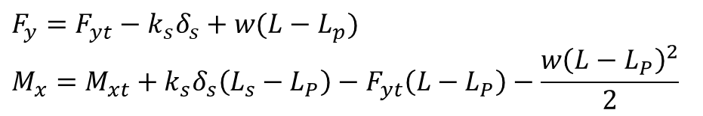
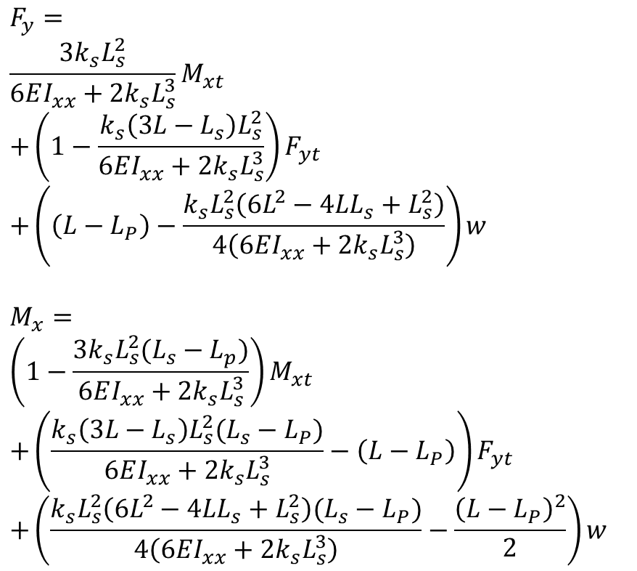
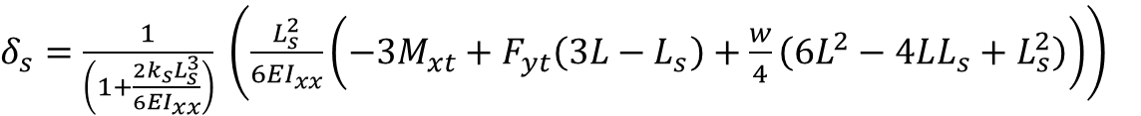
$$y$$
$$x$$
$$z$$
$$F_{s}=k_{s}δ_{s}$$
$δ_{s}=\frac{1}{\left(1+\frac{2k_{s}L_{s}^{3}}{6EI_{xx}}\right)} \left(\frac{L_{s}^{2}}{6EI_{xx}}\left(−3M_{xt}+F_{yt}\left(3L−L_{s}\right)+\frac{w}{4}\left(6L^{2}−4LL_{s}+L_{s}^{2}\right)\right)\right)$
$$L_{P}$$
$$P$$
$$s$$
$$M_{xt}$$
$$w$$
$$F_{yt}$$
$$F_{y}={F_{yt}−k}_{s}δ_{s}+w(L−L_{p})$$
$$M_{x}=M_{xt}+k_{s}δ_{s}\left(L_{s}−L_{P}\right)−F_{yt}\left(L−L_{P}\right)−\frac{w{\left(L−L_{P}\right)}^{2}}{2}$$
$$L_{s}$$
$$L$$
$$F_{y}$$
$$F_{s}=k_{s}δ_{s}$$
$$M_{x}$$
$$P$$
$$s$$
$$M_{xt}$$
$$F_{y}= \\ \frac{3k_{s}L_{s}^{2}}{6EI_{xx}+2k_{s}L_{s}^{3}}M_{xt} \\ +\left(1−\frac{k_{s}\left(3L−L_{s}\right)L_{s}^{2}}{6EI_{xx}+2k_{s}L_{s}^{3}}\right)F_{yt} \\ +\left(\left(L−L_{P}\right)−\frac{k_{s}L_{s}^{2}\left(6L^{2}−4LL_{s}+L_{s}^{2}\right)}{4\left(6EI_{xx}+2k_{s}L_{s}^{3}\right)}\right)w$$
$$M_{x}= \\ \left(1−\frac{3k_{s}L_{s}^{2}(L_{s}−L_{p})}{6EI_{xx}+2k_{s}L_{s}^{3}}\right)M_{xt} \\ +\left(\frac{k_{s}\left(3L−L_{s}\right)L_{s}^{2}(L_{s}−L_{P})}{6EI_{xx}+2k_{s}L_{s}^{3}}−\left(L−L_{P}\right)\right)F_{yt} \\ +\left(\frac{k_{s}L_{s}^{2}\left(6L^{2}−4LL_{s}+L_{s}^{2}\right)(L_{s}−L_{P})}{4\left(6EI_{xx}+2k_{s}L_{s}^{3}\right)}−\frac{{\left(L−L_{P}\right)}^{2}}{2}\right)w$$
$$w$$
$$F_{yt}$$
$$L_{s}−L_{P}$$
$$L−L_{P}$$

Slide 5
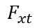
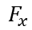
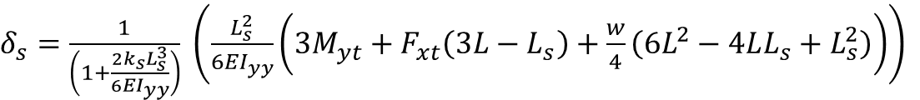
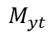
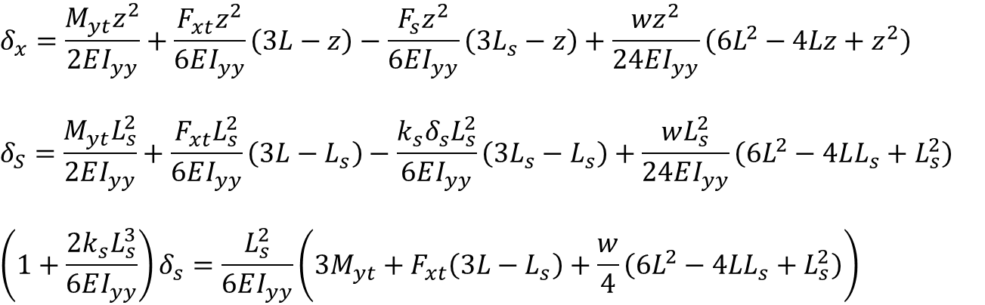
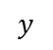
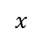
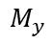
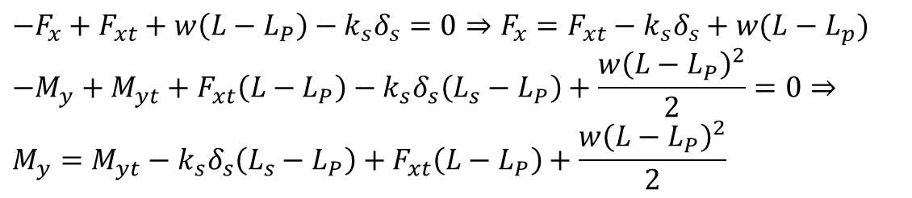
$$x$$
$$y$$
$$z$$
$$F_{s}=k_{s}δ_{s}$$
$$L_{P}$$
$$δ_{x}=\frac{M_{yt}z^{2}}{2EI_{yy}}+\frac{F_{xt}z^{2}}{6EI_{yy}}\left(3L−z\right)−\frac{F_{s}z^{2}}{6EI_{yy}}\left(3L_{s}−z\right)+\frac{wz^{2}}{24EI_{yy}}\left(6L^{2}−4Lz+z^{2}\right)$$
$$δ_{S}=\frac{M_{yt}L_{s}^{2}}{2EI_{yy}}+\frac{F_{xt}L_{s}^{2}}{6EI_{yy}}\left(3L−L_{s}\right)−\frac{k_{s}δ_{s}L_{s}^{2}}{6EI_{yy}}\left(3L_{s}−L_{s}\right)+\frac{wL_{s}^{2}}{24EI_{yy}}\left(6L^{2}−4LL_{s}+L_{s}^{2}\right)$$
$$\left(1+\frac{2k_{s}L_{s}^{3}}{6EI_{yy}}\right)δ_{s}=\frac{L_{s}^{2}}{6EI_{yy}}\left(3M_{yt}+F_{xt}\left(3L−L_{s}\right)+\frac{w}{4}\left(6L^{2}−4LL_{s}+L_{s}^{2}\right)\right)$$
$$P$$
$$s$$
$$M_{yt}$$
$$w$$
$$F_{xt}$$
$$L_{s}$$
$$L$$
$$F_{x}$$
$$F_{s}=k_{s}δ_{s}$$
$$M_{y}$$
$$P$$
$$s$$
$$M_{yt}$$
$$w$$
$$F_{xt}$$
$$L_{s}−L_{P}$$
$$L−L_{P}$$
$δ_{s}=\frac{1}{\left(1+\frac{2k_{s}L_{s}^{3}}{6EI_{yy}}\right)} \left(\frac{L_{s}^{2}}{6EI_{yy}}\left(3M_{yt}+F_{xt}\left(3L−L_{s}\right)+\frac{w}{4}\left(6L^{2}−4LL_{s}+L_{s}^{2}\right)\right)\right)$
$$−F_{x}+F_{xt}+w\left(L−L_{P}\right)−k_{s}δ_{s}=0⇒F_{x}={F_{xt}−k}_{s}δ_{s}+w(L−L_{p})$$
$$−M_{y}+M_{yt}+F_{xt}\left(L−L_{P}\right)−k_{s}δ_{s}\left(L_{s}−L_{P}\right)+\frac{w{\left(L−L_{P}\right)}^{2}}{2}=0⇒ \\ M_{y}=M_{yt}−k_{s}δ_{s}\left(L_{s}−L_{P}\right)+F_{xt}\left(L−L_{P}\right)+\frac{w{\left(L−L_{P}\right)}^{2}}{2}$$

Slide 6
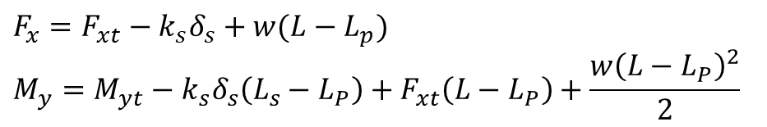
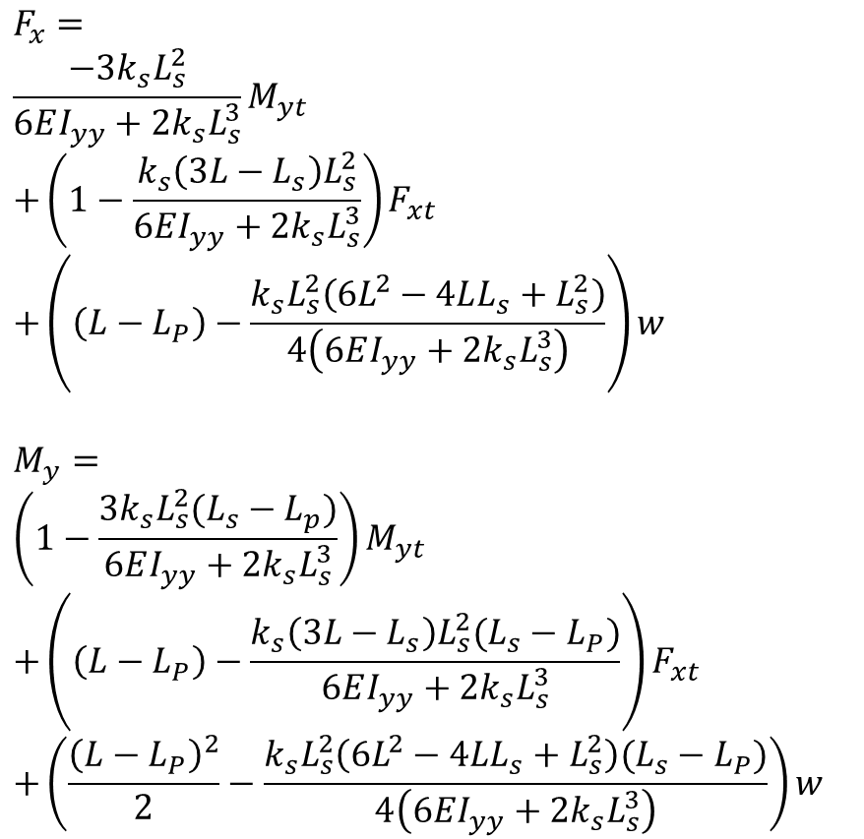
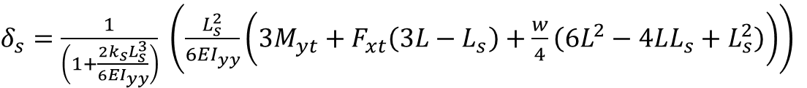
$$x$$
$δ_{s}=\frac{1}{\left(1+\frac{2k_{s}L_{s}^{3}}{6EI_{yy}}\right)} \left(\frac{L_{s}^{2}}{6EI_{yy}}\left(3M_{yt}+F_{xt}\left(3L−L_{s}\right)+\frac{w}{4}\left(6L^{2}−4LL_{s}+L_{s}^{2}\right)\right)\right)$
$$y$$
$$z$$
$$F_{s}=k_{s}δ_{s}$$
$$L_{P}$$
$$P$$
$$s$$
$$M_{yt}$$
$$w$$
$$F_{xt}$$
$$F_{x}={F_{xt}−k}_{s}δ_{s}+w(L−L_{p})$$
$$M_{y}=M_{yt}−k_{s}δ_{s}\left(L_{s}−L_{P}\right)+F_{xt}\left(L−L_{P}\right)+\frac{w{\left(L−L_{P}\right)}^{2}}{2}$$
$$L_{s}$$
$$L$$
$$F_{x}$$
$$F_{s}=k_{s}δ_{s}$$
$$F_{x}= \\ \frac{−3k_{s}L_{s}^{2}}{6EI_{yy}+2k_{s}L_{s}^{3}}M_{yt} \\ +\left(1−\frac{k_{s}\left(3L−L_{s}\right)L_{s}^{2}}{6EI_{yy}+2k_{s}L_{s}^{3}}\right)F_{xt} \\ +\left(\left(L−L_{P}\right)−\frac{k_{s}L_{s}^{2}\left(6L^{2}−4LL_{s}+L_{s}^{2}\right)}{4\left(6EI_{yy}+2k_{s}L_{s}^{3}\right)}\right)w$$
$$M_{y}= \\ \left(1−\frac{3k_{s}L_{s}^{2}(L_{s}−L_{p})}{6EI_{yy}+2k_{s}L_{s}^{3}}\right)M_{yt} \\ +\left(\left(L−L_{P}\right)−\frac{k_{s}\left(3L−L_{s}\right)L_{s}^{2}(L_{s}−L_{P})}{6EI_{yy}+2k_{s}L_{s}^{3}}\right)F_{xt} \\ +\left(\frac{{\left(L−L_{P}\right)}^{2}}{2}−\frac{k_{s}L_{s}^{2}\left(6L^{2}−4LL_{s}+L_{s}^{2}\right)(L_{s}−L_{P})}{4\left(6EI_{yy}+2k_{s}L_{s}^{3}\right)}\right)w$$
$$M_{y}$$
$$P$$
$$s$$
$$M_{yt}$$
$$w$$
$$F_{xt}$$
$$L_{s}−L_{P}$$
$$L−L_{P}$$

Slide 7
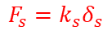
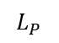
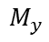





















$$y$$
$$x$$
$$x$$
$$z$$
$$F_{s}=k_{s}δ_{s}$$
$$y$$
$$z$$
$$F_{s}=k_{s}δ_{s}$$
$$L_{P}$$
$$L_{P}$$
$$P$$
$$s$$
$$M_{xt}$$
$$P$$
$$s$$
$$M_{yt}$$
$$w$$
$$F_{yt}$$
$$w$$
$$F_{xt}$$
$$L_{s}$$
$$L_{s}$$
$$L$$
$$L$$
$$F_{y}$$
$$F_{s}=k_{s}δ_{s}$$
$$F_{x}$$
$$F_{s}=k_{s}δ_{s}$$
$$M_{x}$$
$$P$$
$$s$$
$$M_{xt}$$
$$M_{y}$$
$$P$$
$$s$$
$$M_{yt}$$
$$w$$
$$F_{yt}$$
$$w$$
$$F_{xt}$$
$$L_{s}−L_{P}$$
$$L_{s}−L_{P}$$
$$L−L_{P}$$
$$L−L_{P}$$
$$F_{x}= \underset{F_{15}(L_{s})}{\underbrace{\frac{−3k_{s}L_{s}^{2}}{6EI_{yy}+2k_{s}L_{s}^{3}}}}M_{yt}+\underset{F_{11}\left(L_{s}\right)}{\underbrace{\left(1−\frac{k_{s}\left(3L−L_{s}\right)L_{s}^{2}}{6EI_{yy}+2k_{s}L_{s}^{3}}\right)}}F_{xt}+\left(\left(L−L_{P}\right)−\frac{k_{s}L_{s}^{2}\left(6L^{2}−4LL_{s}+L_{s}^{2}\right)}{4\left(6EI_{yy}+2k_{s}L_{s}^{3}\right)}\right)w$$
$$M_{y}= \underset{F_{55}(L_{s})}{\underbrace{\left(1−\frac{3k_{s}L_{s}^{2}(L_{s}−L_{p})}{6EI_{yy}+2k_{s}L_{s}^{3}}\right)}}M_{yt}+\underset{F_{51}\left(L_{s}\right)}{\underbrace{\left(\left(L−L_{P}\right)−\frac{k_{s}\left(3L−L_{s}\right)L_{s}^{2}(L_{s}−L_{P})}{6EI_{yy}+2k_{s}L_{s}^{3}}\right)}}F_{xt}+\left(\frac{{\left(L−L_{P}\right)}^{2}}{2}−\frac{k_{s}L_{s}^{2}\left(6L^{2}−4LL_{s}+L_{s}^{2}\right)(L_{s}−L_{P})}{4\left(6EI_{yy}+2k_{s}L_{s}^{3}\right)}\right)w$$
$$F_{y}=\underset{F_{24}}{\underbrace{\frac{3k_{s}L_{s}^{2}}{6EI_{xx}+2k_{s}L_{s}^{3}}}}M_{xt}+\underset{F_{22}}{\underbrace{\left(1−\frac{k_{s}\left(3L−L_{s}\right)L_{s}^{2}}{6EI_{xx}+2k_{s}L_{s}^{3}}\right)}}F_{yt}+\left(\left(L−L_{P}\right)−\frac{k_{s}L_{s}^{2}\left(6L^{2}−4LL_{s}+L_{s}^{2}\right)}{4\left(6EI_{xx}+2k_{s}L_{s}^{3}\right)}\right)w$$
$$M_{x}= \underset{F_{44}}{\underbrace{\left(1−\frac{3k_{s}L_{s}^{2}(L_{s}−L_{p})}{6EI_{xx}+2k_{s}L_{s}^{3}}\right)}}M_{xt}+\underset{F_{42}}{\underbrace{\left(\frac{k_{s}\left(3L−L_{s}\right)L_{s}^{2}(L_{s}−L_{P})}{6EI_{xx}+2k_{s}L_{s}^{3}}−\left(L−L_{P}\right)\right)}}F_{yt}+\left(\frac{k_{s}L_{s}^{2}\left(6L^{2}−4LL_{s}+L_{s}^{2}\right)(L_{s}−L_{P})}{4\left(6EI_{xx}+2k_{s}L_{s}^{3}\right)}−\frac{{\left(L−L_{P}\right)}^{2}}{2}\right)w$$

Slide 8





$$y$$
$$δ_{y}=−\frac{M_{xt}z^{2}}{2EI_{xx}}+\frac{F_{yt}z^{2}}{6EI_{xx}}\left(3L−z\right)−\frac{F_{s}z^{2}}{6EI_{xx}}\left(3L_{s}−z\right)$$
$$δ_{S}=−\frac{M_{xt}L_{s}^{2}}{2EI_{xx}}+\frac{F_{yt}L_{s}^{2}}{6EI_{xx}}\left(3L−L_{s}\right)−\frac{(F_{sy}+k_{s}δ_{s})L_{s}^{2}}{6EI_{xx}}\left(3L_{s}−L_{s}\right)$$
$$\left(1+\frac{2k_{s}L_{s}^{3}}{6EI_{xx}}\right)δ_{s}=\frac{L_{s}^{2}}{6EI_{xx}}\left(−3M_{xt}+F_{yt}\left(3L−L_{s}\right)−2F_{sy}L_{s}\right)$$
$$x$$
$$z$$
$$F_{s}=k_{s}δ_{s}$$
$$L_{P}$$
$$P$$
$$s$$
$$M_{xt}$$
$$w$$
$$F_{yt}$$
$$L_{s}$$
$$L$$
$$F_{y}$$
$$F_{s}=k_{s}δ_{s}$$
$$δ_{s}=\frac{1}{\left(1+\frac{2k_{s}L_{s}^{3}}{6EI_{xx}}\right)} \left(\frac{L_{s}^{2}}{6EI_{xx}}\left(−3M_{xt}+F_{yt}\left(3L−L_{s}\right)−2F_{sy}L_{s}\right)\right)$$
$$M_{x}$$
$$P$$
$$s$$
$$M_{xt}$$
$$δ_{s}=\frac{L_{s}^{2}}{6EI_{xx}+2k_{s}L_{s}^{3}}\left(−3M_{xt}+F_{yt}\left(3L−L_{s}\right)−2F_{sy}L_{s}\right)$$
$$w$$
$$F_{yt}$$
$$L_{s}−L_{P}$$
$$L−L_{P}$$
$$−F_{y}+F_{yt}−k_{s}δ_{s}−F_{sy}=0⇒F_{y}={F_{yt}−k}_{s}δ_{s}−F_{sy}$$
$$−M_{x}+M_{xt}−F_{yt}\left(L−L_{P}\right)+k_{s}δ_{s}\left(L_{s}−L_{P}\right)+F_{sy}(L_{s}−L_{P})=0⇒ \\ M_{x}=M_{xt}+k_{s}δ_{s}\left(L_{s}−L_{P}\right)−F_{yt}\left(L−L_{P}\right)+F_{sy}(L_{s}−L_{P})$$
$$F_{y}=\left(1−\frac{k_{s}L_{s}^{2}\left(3L−L_{s}\right)}{6EI_{xx}+2k_{s}L_{s}^{3}}\right)F_{yt}+\left(\frac{3k_{s}L_{s}^{2}}{6EI_{xx}+2k_{s}L_{s}^{3}}\right)M_{xt}−\left(1−\frac{2k_{s}L_{s}^{3}}{6EI_{xx}+2k_{s}L_{s}^{3}}\right)F_{sy}$$
$$M_{x}=\left(1−\frac{{3k}_{s}L_{s}^{2}\left(L_{s}−L_{P}\right)}{6EI_{xx}+2k_{s}L_{s}^{3}}\right)M_{xt}−\left(\left(L−L_{P}\right)+\frac{k_{s}L_{s}^{2}\left(3L−L_{s}\right)}{6EI_{xx}+2k_{s}L_{s}^{3}}\right)F_{yt}+\left(\left(L_{s}−L_{P}\right)−\frac{2k_{s}L_{s}^{3}\left(L_{s}−L_{P}\right)}{6EI_{xx}+2k_{s}L_{s}^{3}}\right)F_{sy}$$

Slide 9




$$x$$
$$y$$
$$z$$
$$F_{s}=k_{s}δ_{s}$$
$$L_{P}$$
$$δ_{x}=\frac{M_{yt}z^{2}}{2EI_{yy}}+\frac{F_{xt}z^{2}}{6EI_{yy}}\left(3L−z\right)−\frac{F_{s}z^{2}}{6EI_{yy}}\left(3L_{s}−z\right)$$
$$δ_{S}=\frac{M_{yt}L_{s}^{2}}{2EI_{yy}}+\frac{F_{xt}L_{s}^{2}}{6EI_{yy}}\left(3L−L_{s}\right)−\frac{(F_{sx}+k_{s}δ_{s})L_{s}^{2}}{6EI_{yy}}\left(3L_{s}−L_{s}\right)$$
$$\left(1+\frac{2k_{s}L_{s}^{3}}{6EI_{yy}}\right)δ_{s}=\frac{L_{s}^{2}}{6EI_{yy}}\left(3M_{yt}+F_{xt}\left(3L−L_{s}\right)−2F_{sx}L_{s}\right)$$
$$P$$
$$s$$
$$M_{yt}$$
$$w$$
$$F_{xt}$$
$$L_{s}$$
$$L$$
$$F_{x}$$
$$F_{s}=k_{s}δ_{s}$$
$δ_{s}=\frac{1}{\left(1+\frac{2k_{s}L_{s}^{3}}{6EI_{yy}}\right)} \left(\frac{L_{s}^{2}}{6EI_{yy}}\left(3M_{yt}+F_{xt}\left(3L−L_{s}\right)−2F_{sx}L_{s}\right)\right)$
$$M_{y}$$
$$P$$
$$s$$
$$M_{yt}$$
$$w$$
$$F_{xt}$$
$$L_{s}−L_{P}$$
$$δ_{s}=\frac{L_{s}^{2}}{6EI_{yy}+2k_{s}L_{s}^{3}}\left(3M_{yt}+F_{xt}\left(3L−L_{s}\right)−2F_{sx}L_{s}\right)$$
$$L−L_{P}$$
$$−F_{x}+F_{xt}−k_{s}δ_{s}−F_{sx}=0⇒F_{x}={F_{xt}−k}_{s}δ_{s}−F_{sx}$$
$$−M_{y}+M_{yt}+F_{xt}\left(L−L_{P}\right)−k_{s}δ_{s}\left(L_{s}−L_{P}\right)−F_{sx}(L_{s}−L_{P})=0⇒$$ $M_{y}=M_{yt}−k_{s}δ_{s}\left(L_{s}−L_{P}\right)+F_{xt}\left(L−L_{P}\right)$ $−F_{sx}(L_{s}−L_{P})$
$$F_{x}=\left(1−\frac{k_{s}L_{s}^{2}\left(3L−L_{s}\right)}{6EI_{yy}+2k_{s}L_{s}^{3}}\right)F_{xt}−\frac{3k_{s}L_{s}^{2}}{6EI_{yy}+2k_{s}L_{s}^{3}}M_{yt}−\left(1−\frac{2k_{s}L_{s}^{3}}{6EI_{yy}+2k_{s}L_{s}^{3}}\right)F_{sx}$$
$$M_{y}=\left(1−\frac{3k_{s}L_{s}^{2}\left(L_{s}−L_{P}\right)}{6EI_{yy}+2k_{s}L_{s}^{3}}\right)M_{yt}+\left(\left(L−L_{P}\right)−\frac{k_{s}L_{s}^{2}\left(3L−L_{s}\right)}{6EI_{yy}+2k_{s}L_{s}^{3}}\right)F_{xt}−\left((L_{s}−L_{P})−\frac{2k_{s}L_{s}^{3}}{6EI_{yy}+2k_{s}L_{s}^{3}}\right)F_{sx}$$

Slide 10

$$F_{x}=\left(1−\frac{k_{s}L_{s}^{2}\left(3L−L_{s}\right)}{6EI_{yy}+2k_{s}L_{s}^{3}}\right)F_{xt}−\frac{3k_{s}L_{s}^{2}}{6EI_{yy}+2k_{s}L_{s}^{3}}M_{yt}−\left(1−\frac{2k_{s}L_{s}^{3}}{6EI_{yy}+2k_{s}L_{s}^{3}}\right)F_{sx}$$
$$M_{y}=\left(1−\frac{3k_{s}L_{s}^{2}\left(L_{s}−L_{P}\right)}{6EI_{yy}+2k_{s}L_{s}^{3}}\right)M_{yt}+\left(\left(L−L_{P}\right)−\frac{k_{s}L_{s}^{2}\left(3L−L_{s}\right)}{6EI_{yy}+2k_{s}L_{s}^{3}}\right)F_{xt}−\left((L_{s}−L_{P})−\frac{2k_{s}L_{s}^{3}(L_{s}−L_{P})}{6EI_{yy}+2k_{s}L_{s}^{3}}\right)F_{sx}$$
$$F_{y}=\left(1−\frac{k_{s}L_{s}^{2}\left(3L−L_{s}\right)}{6EI_{xx}+2k_{s}L_{s}^{3}}\right)F_{yt}+\left(\frac{3k_{s}L_{s}^{2}}{6EI_{xx}+2k_{s}L_{s}^{3}}\right)M_{xt}−\left(1−\frac{2k_{s}L_{s}^{3}}{6EI_{xx}+2k_{s}L_{s}^{3}}\right)F_{sy}$$
$$M_{x}=\left(1−\frac{{3k}_{s}L_{s}^{2}\left(L_{s}−L_{P}\right)}{6EI_{xx}+2k_{s}L_{s}^{3}}\right)M_{xt}−\left(\left(L−L_{P}\right)+\frac{k_{s}L_{s}^{2}\left(3L−L_{s}\right)}{6EI_{xx}+2k_{s}L_{s}^{3}}\right)F_{yt}+\left(\left(L_{s}−L_{P}\right)−\frac{2k_{s}L_{s}^{3}\left(L_{s}−L_{P}\right)}{6EI_{xx}+2k_{s}L_{s}^{3}}\right)F_{sy}$$
$$g=\frac{k_{s}L_{s}^{2}}{6EI_{yy}+2k_{s}L_{s}^{3}}$$
$$F_{x}=\left(1−\left(3L−L_{s}\right)g(c_{y})\right)F_{xt}−3g\left(c_{y}\right)M_{yt}−\left(1−2L_{s}g(c_{y})\right)F_{sx}$$
$$M_{y}=\left(1−3\left(L_{s}−L_{P}\right)g\left(c_{y}\right)\right)M_{yt}+\left(\left(L−L_{P}\right)−\left(3L−L_{s}\right)g(c_{y})\right)F_{xt}−\left(\left(L_{s}−L_{P}\right)−2L_{s}\left(L_{s}−L_{P}\right)g(c_{y})\right)F_{sx}$$
$$F_{y}=\left(1−\left(3L−L_{s}\right)g\left(c_{x}\right)\right)F_{yt}+3g\left(c_{x}\right)M_{xt}−\left(1−2L_{s}g(c_{x})\right)F_{sy}$$
$$M_{x}=\left(1−3\left(L_{s}−L_{P}\right)g\left(c_{x}\right)\right)M_{xt}−\left(\left(L−L_{P}\right)+\left(3L−L_{s}\right)g(c_{x})\right)F_{yt}+\left(\left(L_{s}−L_{P}\right)−2L_{s}\left(L_{s}−L_{P}\right)g(c_{x})\right)F_{sy}$$

Slide 11


$$A\left[\begin{aligned}N_{n1} \\ N_{n2} \\ N_{n3} \\ N_{n4} \\ N_{n5} \\ N_{n6}\end{aligned}\right]=\left[\begin{aligned}F_{x} \\ F_{y} \\ F_{z} \\ M_{x} \\ M_{y} \\ M_{z}\end{aligned}\right]=\left[\begin{matrix}F_{11}\left(L_{s}\right) & 0 & 0 & 0 & F_{15}\left(Ls\right) & 0 \\ 0 & F_{22}\left(L_{s}\right) & 0 & F_{24}\left(L_{s}\right) & 0 & 0 \\ 0 & 0 & 1 & 0 & 0 & 0 \\ 0 & F_{42}\left(L_{s}\right) & 0 & F_{44}\left(L_{s}\right) & 0 & 0 \\ F_{51}\left(L_{s}\right) & 0 & 0 & 0 & F_{55}\left(L_{s}\right) & 0 \\ 0 & 0 & 0 & 0 & 0 & 1\end{matrix}\right]\left[\begin{aligned}\begin{aligned}F_{xt} \\ F_{yt} \\ F_{zt} \\ M_{xt} \\ M_{yt} \\ M_{zt}\end{aligned}\end{aligned}\right]$$
Input force profile loaded from the
ATI force sensor readings of the force
sensor calibration in TRO paper
The calibration matrix calculated in the
TRO paper when the sensor is mounted on a steel shaft

Slide 12




$$\left[\begin{aligned}\begin{aligned}F_{xt} \\ F_{yt} \\ F_{zt} \\ M_{xt} \\ M_{yt} \\ M_{zt}\end{aligned}\end{aligned}\right]$$
$$\left[\begin{aligned}N_{n1} \\ N_{n2} \\ N_{n3} \\ N_{n4} \\ N_{n5} \\ N_{n6}\end{aligned}\right]$$

Slide 13









$$F_{11}=1−\frac{k_{s}\left(3L−L_{s}\right)L_{s}^{2}}{6EI_{yy}+2k_{s}L_{s}^{3}}=1−\left(3L−L_{s}\right)g\left(c_{y},L_{s}\right)$$
$$\left[\begin{aligned}N_{n1} \\ N_{n2} \\ N_{n3} \\ N_{n4} \\ N_{n5} \\ N_{n6}\end{aligned}\right]=A^{−1 }\underset{H}{\underbrace{\left[\begin{matrix}F_{11} & 0 & 0 & 0 & F_{15} & 0 \\ 0 & F_{22} & 0 & F_{24} & 0 & 0 \\ 0 & 0 & 1 & 0 & 0 & 0 \\ 0 & F_{42} & 0 & F_{44} & 0 & 0 \\ F_{51} & 0 & 0 & 0 & F_{55} & 0 \\ 0 & 0 & 0 & 0 & 0 & 1\end{matrix}\right]}}\left[\begin{aligned}\begin{aligned}F_{xt} \\ F_{yt} \\ F_{zt} \\ M_{xt} \\ M_{yt} \\ M_{zt}\end{aligned}\end{aligned}\right]$$
$$F_{15}= \frac{−3k_{s}L_{s}^{2}}{6EI_{yy}+2k_{s}L_{s}^{3}}=−3g\left(c_{y},L_{s}\right)$$
$$F_{22}=1−\frac{k_{s}\left(3L−L_{s}\right)L_{s}^{2}}{6EI_{xx}+2k_{s}L_{s}^{3}}=1−\left(3L−L_{s}\right)g(c_{x},L_{s})$$
$$F_{24}=\frac{3k_{s}L_{s}^{2}}{6EI_{xx}+2k_{s}L_{s}^{3}}=3g\left(c_{x},L_{s}\right)$$
$$L_{s}=L_{s,OS}+q_{5}$$
$$F_{42}=\frac{k_{s}\left(3L−L_{s}\right)L_{s}^{2}(L_{s}−L_{P})}{6EI_{xx}+2k_{s}L_{s}^{3}}−\left(L−L_{P}\right)=\left(3L−L_{s}\right)\left(L_{s}−L_{P}\right)g\left(c_{x},L_{s}\right)−\left(L−L_{P}\right)$$
$$F_{44}=1−\frac{3k_{s}L_{s}^{2}\left(L_{s}−L_{p}\right)}{6EI_{xx}+2k_{s}L_{s}^{3}}=1−3\left(L_{s}−L_{P}\right)g\left(c_{x},L_{s}\right)$$
$$F_{51}=\left(L−L_{P}\right)−\frac{k_{s}\left(3L−L_{s}\right)L_{s}^{2}\left(L_{s}−L_{P}\right)}{6EI_{yy}+2k_{s}L_{s}^{3}}=\left(L−L_{P}\right)−\left(3L−L_{s}\right)\left(L_{s}−L_{P}\right)g\left(c_{y},L_{s}\right)$$
$$F_{55}=1−\frac{3k_{s}L_{s}^{2}\left(L_{s}−L_{p}\right)}{6EI_{yy}+2k_{s}L_{s}^{3}}=1−3\left(L_{s}−L_{P}\right)g\left(c_{y},L_{s}\right)$$

Slide 14



Total Parameters: 41
6x6 parameters in matrix $A$
length of the shaft $L$
Lumped shaft parameter: $c_{x},c_{y}$
Location of the cross-section: $L_{P}$
Encoder offset for instrument insertion: $L_{s},os$
Cost function: $Σ_{i=1}^{N}{\left\|AN_{ni}−H_{i}\left(c,L,L_{s,os}\right)F_{ti}\right\|}_{2}^{2}$
The optimization problem is not convex because there is a calibration matrix A for any arbitrarily selected $L_{P}$
So we arbitrarily select $L_{P}$ and we end up with 40 parameters
Implement coordinate optimization and projected gradient method with the constraints below:
Select: $L_{P}<\min\left(L_{s}\right)$
$$0.1 c_{n}<c_{x}, c_{y}<10 c_{n} \\ \max\left(L_{s}\right)<L<1.5 L_{n}$$
Fix $c_{x}$ and $c_{y}$ to an initial value, solve for $A$, $L$, and $L_{s,os}$.
Then fix $A, L, L_{s,os}$and solve for $c_{x}$ and $c_{y}$
Iterate between 1 and 2

Slide 15


Slide 16


Slide 17


Slide 18





Fontanelli et al. 2017
For the case of the instrument used in the experiments, the dynamic effects (gravity and inertial forces) are small compared to the range of the measured forces (about 1% of the maximum force) and could be neglected. Of course, when instruments with higher weight and inertia are used, the dynamic effects should be compensated.
Schwalb et al. 2017
During MIS, inertia is low and is assumed to be negligible, and is further validated in the experimental results section.
$$\left[\begin{aligned}F_{x} \\ F_{y} \\ F_{z} \\ M_{x} \\ M_{y} \\ M_{z}\end{aligned}\right]=\left[\begin{matrix}F_{11}\left(L_{s}\right) & 0 & 0 & 0 & F_{15}\left(Ls\right) & 0 \\ 0 & F_{22}\left(L_{s}\right) & 0 & F_{24}\left(L_{s}\right) & 0 & 0 \\ 0 & 0 & 1 & 0 & 0 & 0 \\ 0 & F_{42}\left(L_{s}\right) & 0 & F_{44}\left(L_{s}\right) & 0 & 0 \\ F_{51}\left(L_{s}\right) & 0 & 0 & 0 & F_{55}\left(L_{s}\right) & 0 \\ 0 & 0 & 0 & 0 & 0 & 1\end{matrix}\right]\left[\begin{aligned}\begin{aligned}F_{xt} \\ F_{yt} \\ F_{zt} \\ M_{xt} \\ M_{yt} \\ M_{zt}\end{aligned}\end{aligned}\right]$$
Assuming $I_{xx} = I_{yy}$
$$F_{11}=F_{22}, F_{15}=−F_{24},F_{42}=−F_{51},F_{44}=F_{55}$$
Assuming $M_{xt} = 0$and $M_{yt}$= 0
We do not need to identify: $F_{15},F_{24},F_{44},F_{55}$
$$\left[\begin{aligned}F_{x} \\ F_{y} \\ F_{z} \\ M_{x} \\ M_{y} \\ M_{z}\end{aligned}\right]=\left[\begin{matrix}F_{11}\left(L_{s}\right) & 0 & 0 & 0 \\ 0 & F_{11}\left(L_{s}\right) & 0 & 0 \\ 0 & 0 & 1 & 0 \\ 0 & F_{42}\left(L_{s}\right) & 0 & 0 \\ {−F}_{42}\left(L_{s}\right) & 0 & 0 & 0 \\ 0 & 0 & 0 & 1\end{matrix}\right]\left[\begin{aligned}\begin{aligned}F_{xt} \\ F_{yt} \\ F_{zt} \\ M_{zt}\end{aligned}\end{aligned}\right]$$
We only need to identify two functions, $F_{11}$ and $F_{42}$
$$F_{11}=1−\frac{L_{s}^{2}\left(3L−L_{s}\right)}{c+2L_{s}^{3}}$$
$$F_{42}= \frac{L_{s}^{2}\left(3L−L_{s}\right)(L_{s}−L_{P})}{c+2L_{s}^{3}}−\left(L−L_{P}\right)$$

Slide 19



Slide 20













$$y$$
$$B$$
$$x$$
$$z$$
$$H$$
$$\vec{e_{1}}$$
$$\vec{l_{1}}$$
$$d_{z}$$
$$H′$$
$$C$$
$$r_{s}$$
$$P$$

Slide 22









$$\vec{e_{2}}$$
$$y$$
$$\vec{e_{3}}$$
$$\vec{e_{1}}$$
$$x$$
$$\vec{e_{4}}$$
$$r_{s}$$
$$\vec{e_{6}}$$
$$\vec{e_{5}}$$

Slide 23

Interconnect Flex
Bicell Board
Adjustment Gear
Infrared LED
Bicell Photodiode
Onboard ADC

Slide 24


Slide 25
Model-based Calibration

Slide 26



Slide 27


Slide 28
Neural Network Calibration

Slide 29


Elapsed time is 0.001796 seconds.
45 minutes training

Slide 30




Slide 31


Elapsed time is 0.001754 seconds.
45 minutes training

Slide 32




Slide 33


Slide 34


Slide 35


Slide 36


Slide 37



Compliant Trocar with an overcoat
6-Axis Optical Force Sensor
Mounted onto the proximal shaft of the instrument

Slide 38


6-Axis Optical Force Sensor
Mounted onto the proximal shaft of the instrument
Compliant Cannula with an outer tube overcoat

Slide 39





Leaf Spring
Inner Tube
Outer Tube

Slide 40





Slide 41



Slide 42


Slide 43

Power/Com Board
Active Component
Sensing units
Light Modulators
Passive Component

Slide 44



Slide 45



















$$b$$
$$x$$
$$y$$
$$m_{cx}$$
$$l_{c}$$
$$f_{cy}$$
$$c$$
$$z$$
$$l_{s}$$
$$l$$
$$k_{s}$$
$$f_{s}=k_{s}δ_{s}$$
$$f_{s}$$
$$s$$
$$t$$
$$f_{y}$$
$$m_{x}$$

Slide 46

Leaf Spring
Inner Tube
Outer Tube - Overcoat

Slide 47








0.866 $r$
0.866$r$
$$k_{l}$$
$$k_{l}$$
$$k_{l}$$
$$l_{t}$$

Slide 48











$$x$$
$$y$$
$$z$$
$$x^{′}$$
$$y^{′}$$
$$z′$$
$$r$$
$$l_{t}$$

Slide 49



Slide 50










Modulated Light
$$δ∝\frac{I_{1}−I_{2}}{I_{1}+I_{2}}$$
Compliant Structure
(1)
(2)
$$y$$
$$f_{x}$$
$$m_{y}$$
Bi-cell Photodiode
$$h$$
$$z$$
Cell 1
Cell 2
IR LED
$$g$$
Optical Slit
$$s$$

Slide 51


Slide 52


Slide 53



Slide 54



Slide 55



